Slide 1

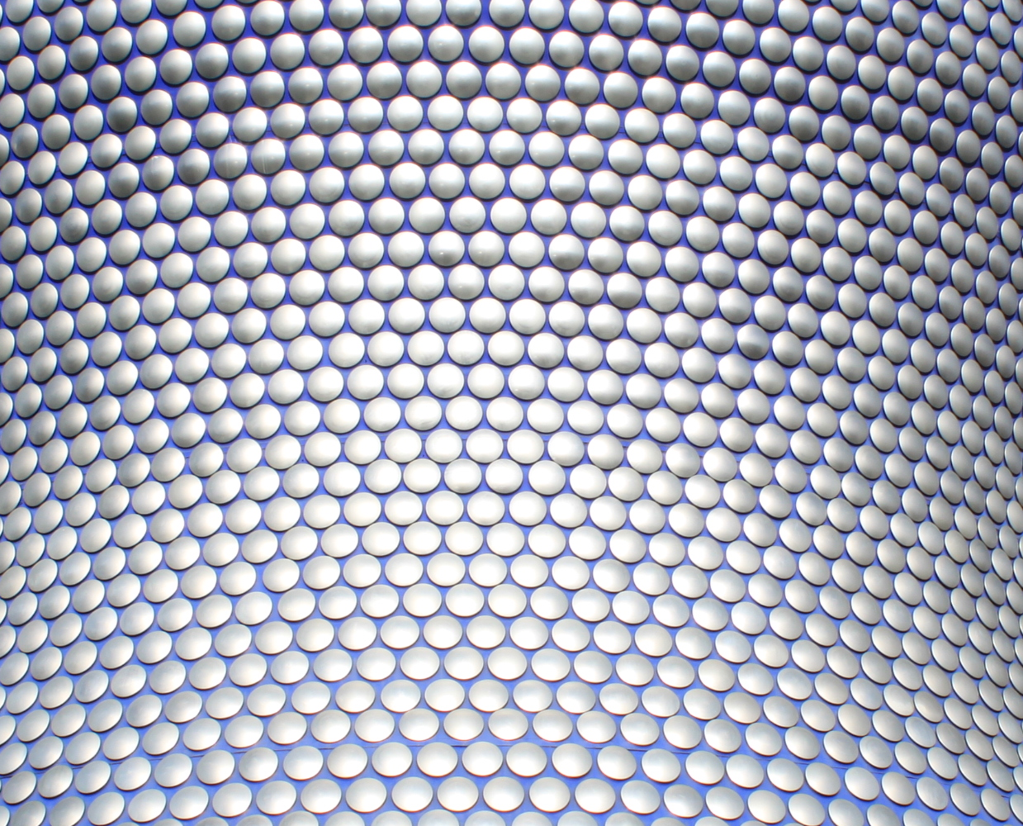

Front slide option 1 – Flat colour – Image sent to back
Colours:
Fonts:
Title font: Open sans light bold, size 40
Subtitle: opens san light, font size 18
#4BBDAD
Rgb: 75,189,173
#FFC100
Rgb: 255,193,0
#FF9A00
Rgb:255,154,0
#0C1938
Rgb: 12,25,56
Interactive Visualisation
With Shiny
#848483
Rgb: 132,132,131
#FF7400
Rgb: 255,116,0
#DDDAE1
Rgb: 221,218,225
#FF4D00
Rgb: 255,77,0

Slide 2
Agenda slide – orange block heights represents time spent on each section
Agenda
Why?
What is Shiny?
Build some apps
Where next?

Slide 3
Section title – Flat colour – Image sent to back
Why?

Slide 4
Why Visualisation?
The primary objective of a visualisation is to communicate.
Explore
Report

Slide 5
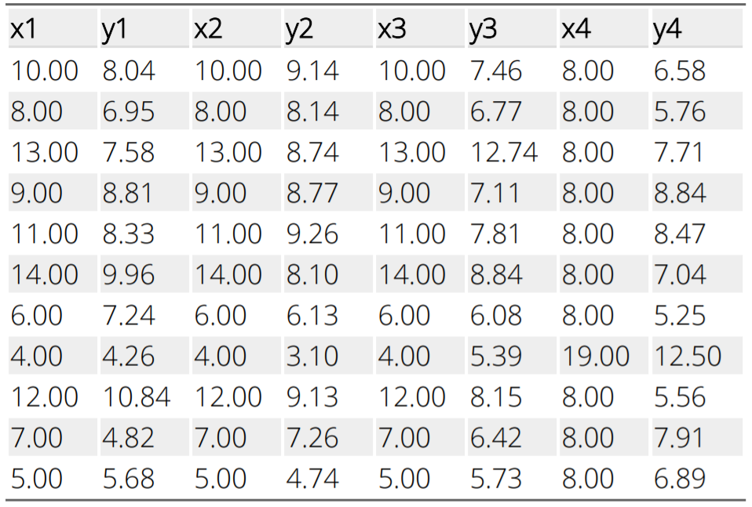
Why Visualisation?

Slide 6
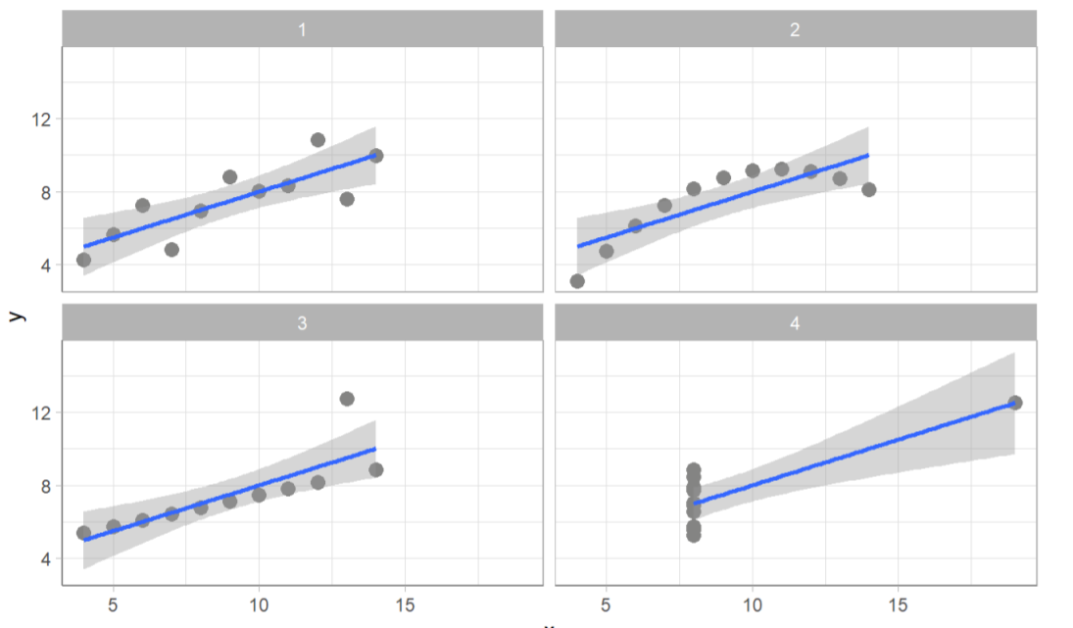
Why Visualisation?

Slide 7
Why Interactive?
Dynamic
Up to date

Slide 8
Section title – Flat colour – Image sent to back
What is Shiny?

Slide 9

What is Shiny?
R Package
Allows creation of web applications
No HTML/CSS/JavaScript/... required
Can be written entirely in R

Slide 10

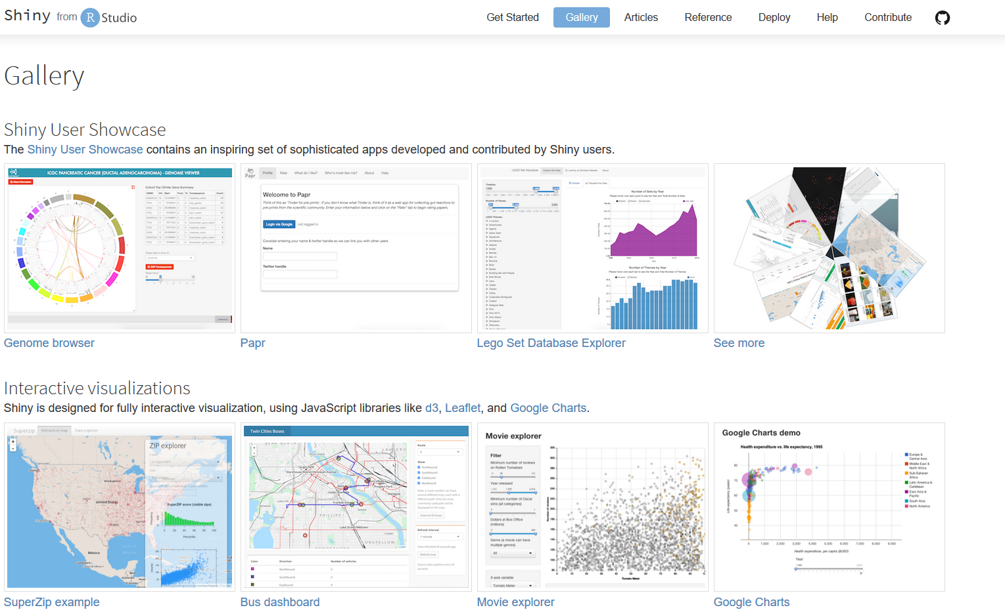
Content slide
Image to right - Squared off / Coloured M logo
What’s Shiny For?
Allowing your app users (friends, colleagues, the public) to benefit from R’s amazing functionality without them needing to learn R
Notes:
Presenting results of analysis to end users in the form of graphics and tables, allowing limited interaction such as selecting sub-groups of the data
Displaying current status and presenting recommended next actions based on R models
Automated production of common reports, letting users upload their own data that can be viewed in a standard way

Slide 11
Section title – Flat colour – Image sent to back
Building Apps

Slide 12
Prerequisites
Link to GitHub REPO
R + RStudio

Slide 13
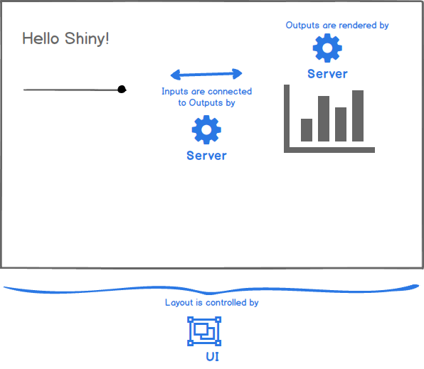
A Basic Shiny App
Requires two components:
A UI (User Interface) that defines how your app looks
A server that defines how your app works

Slide 14
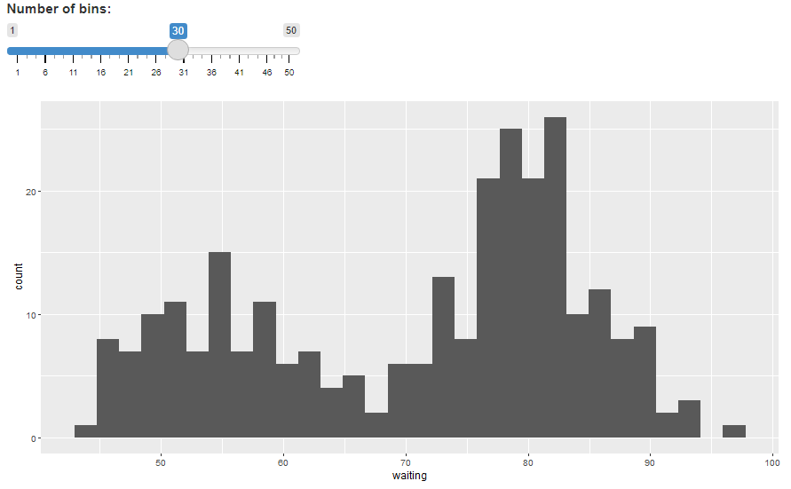
Demo App

Slide 15
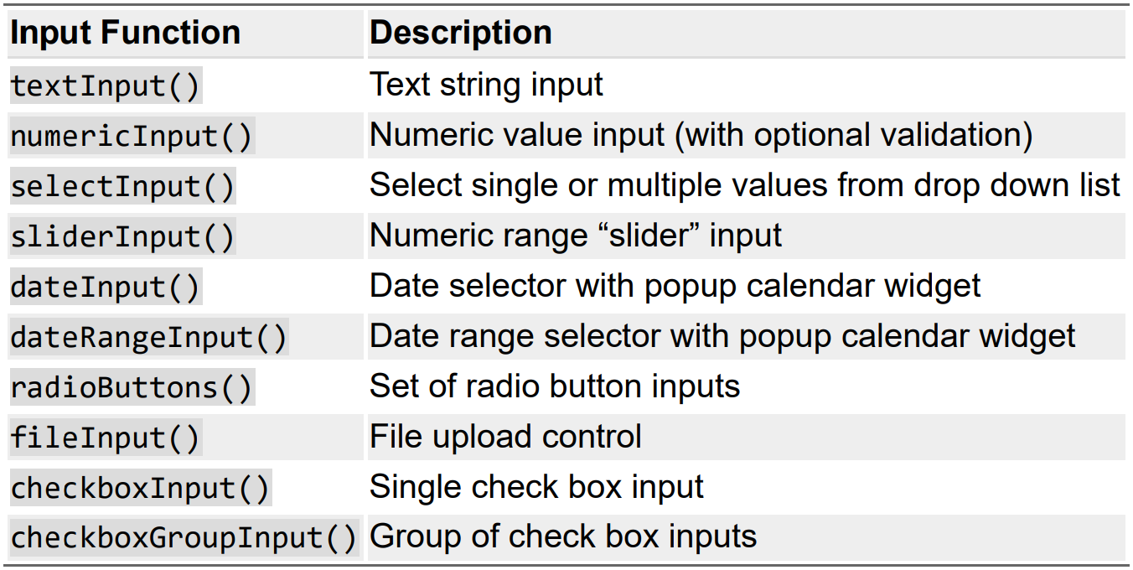
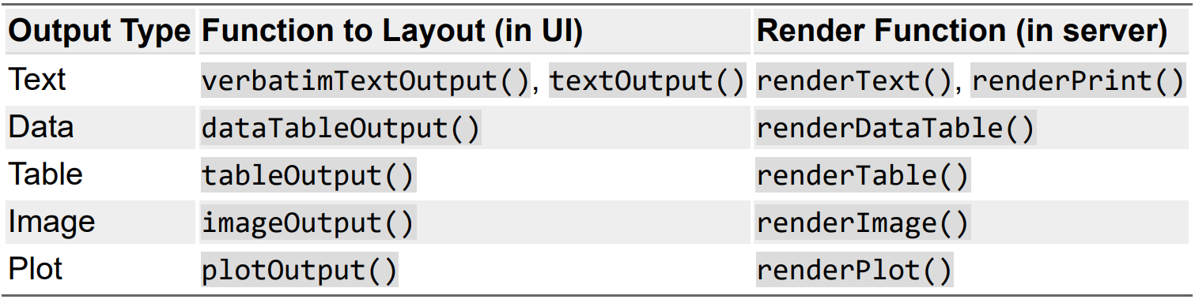
Inputs and Outputs

Slide 16
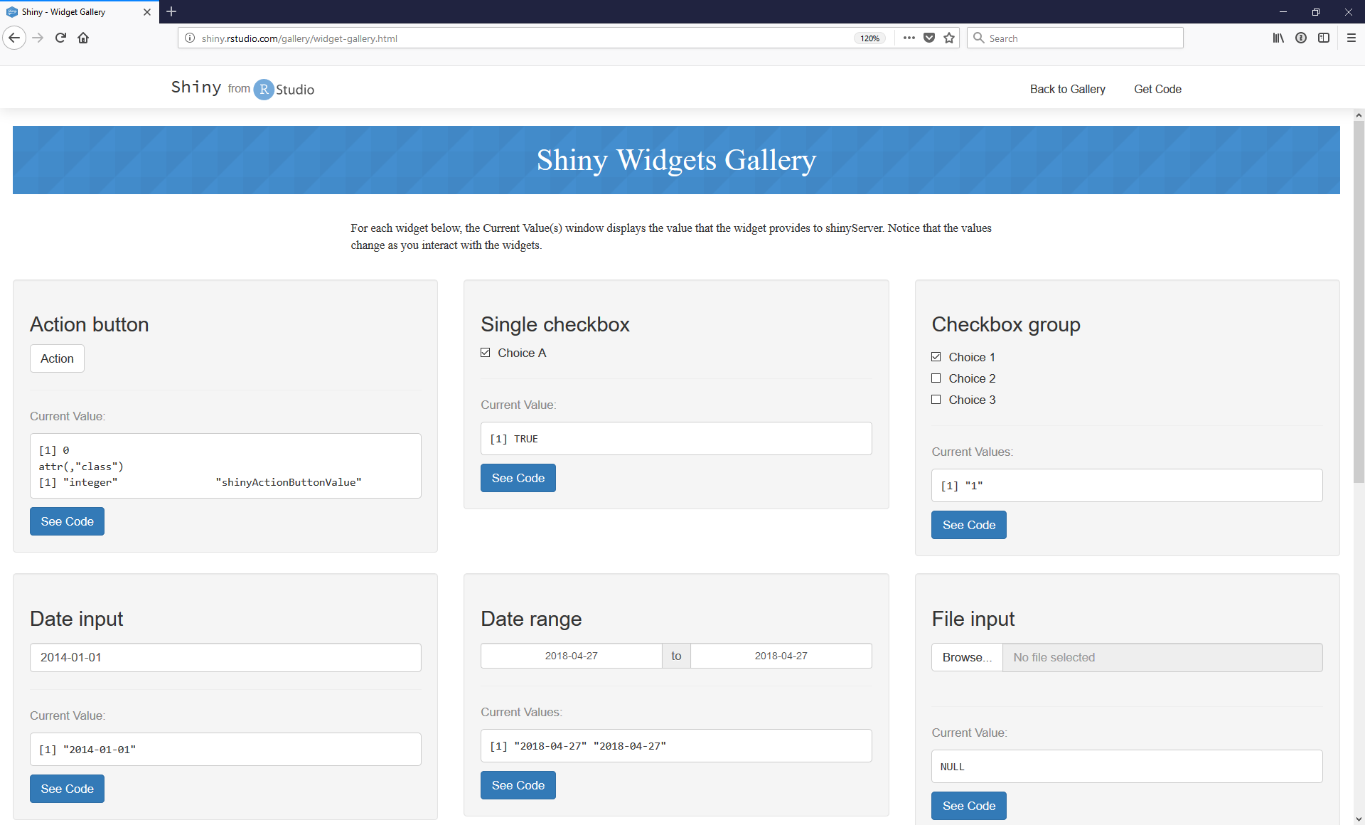
Shiny Widgets

Slide 17
Section title – Flat colour – Image sent to back
Sharing apps

Slide 18
Section title – Flat colour – Image sent to back
Where Next?

Slide 19
Content slide
Image to right - Squared off / Coloured M logo
Where Next?
shiny.rstudio.com
community.rstudio.com
htmlwidgets.org
shinyapps.io
Notes:
Presenting results of analysis to end users in the form of graphics and tables, allowing limited interaction such as selecting sub-groups of the data
Displaying current status and presenting recommended next actions based on R models
Automated production of common reports, letting users upload their own data that can be viewed in a standard way

Slide 20
Section title – Flat colour – Image sent to back
Questions?

